Slide 1

Another Prison Escape Game
ADARSH S L6 GDD

Slide 2
Another Prison Escape Game
About
Another prison escape game is a top down game where the aim of the player is to escape a prison without getting caught by cameras or prison guards.
The player has to find hidden keys to open locked doors to progress the game.
The Core Gameplay
The main objective is to avoid enemy contact and find an escape route on the map. The map features multiple cells to hide and office room to find hidden items. Games over when player comes in contact with security guards or cameras.

Slide 3
Another Prison Escape Game
Game Mechanics
The players uses the basic WASD controls for movement. E can be used to interact with objects like opening doors. Certain main doors require keys that can be found on the hidden rooms. The player has to navigate through the maze and find the exit.
Social Network Elements
The game published on itch.io where anyone with the link can access and play the game.
Menu and HUD
The main menu consists of a play button to start the game. The instructions are also written near the play button. The menu follows the art style of the game..

Slide 4
Another Prison Escape Game
Level Details
The game consists of 1 huge level which is divided into 3 sections. The difficulty gets increased as the game progresses..
Game Elements
The game features the player, a convict trying to escape.
Prison cells and offices.
Security guard that patrols the place.
Security cameras that detect everything.
Keys that you have to find to unlock locked doors.

Slide 5









Another Prison Escape Game
Assets

Slide 6

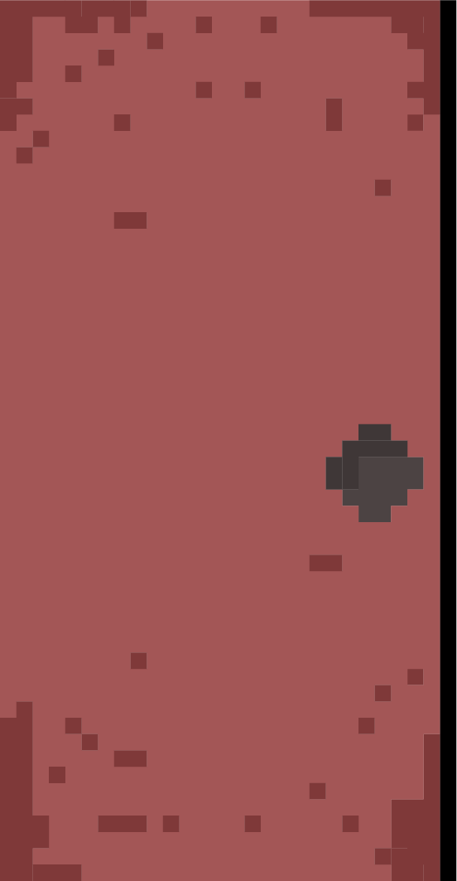
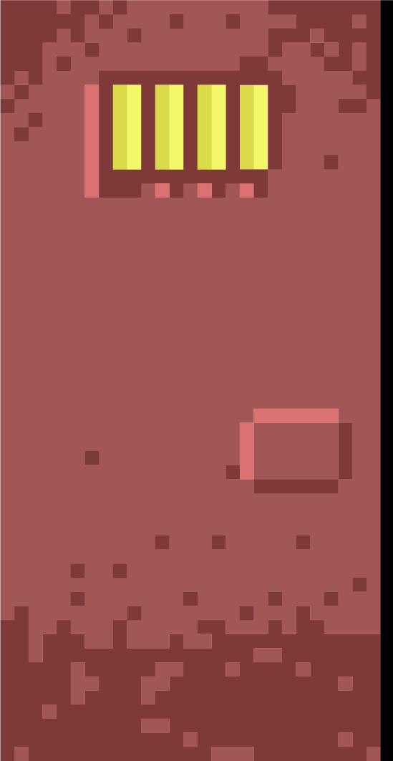
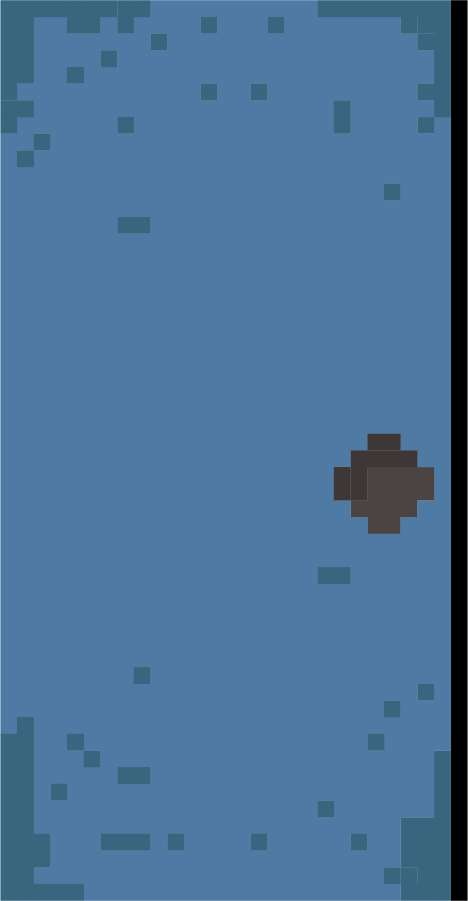


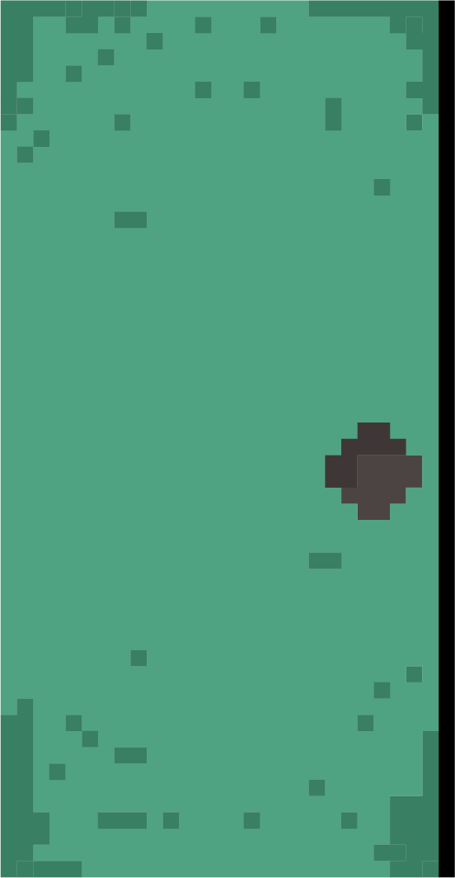






Another Prison Escape Game
Assets

Slide 7






Another Prison Escape Game
Assets

